Slide 1


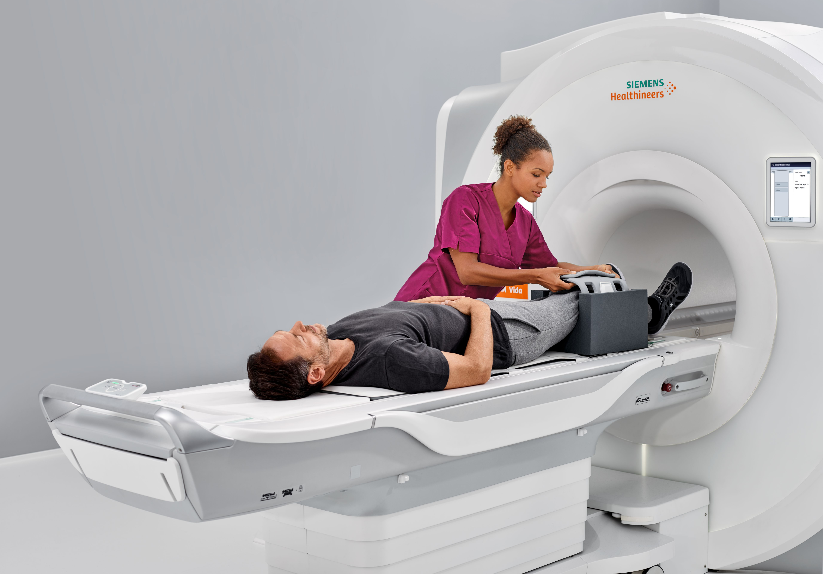
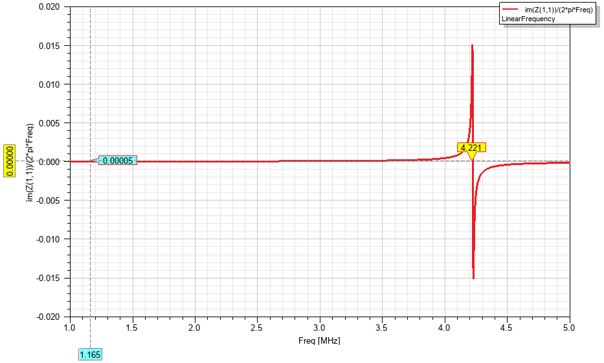
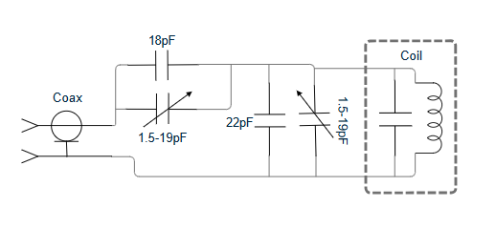
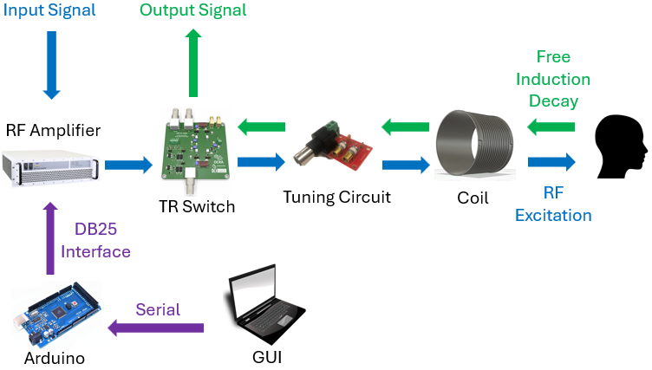
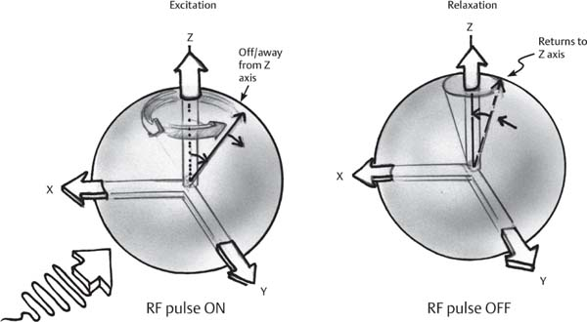
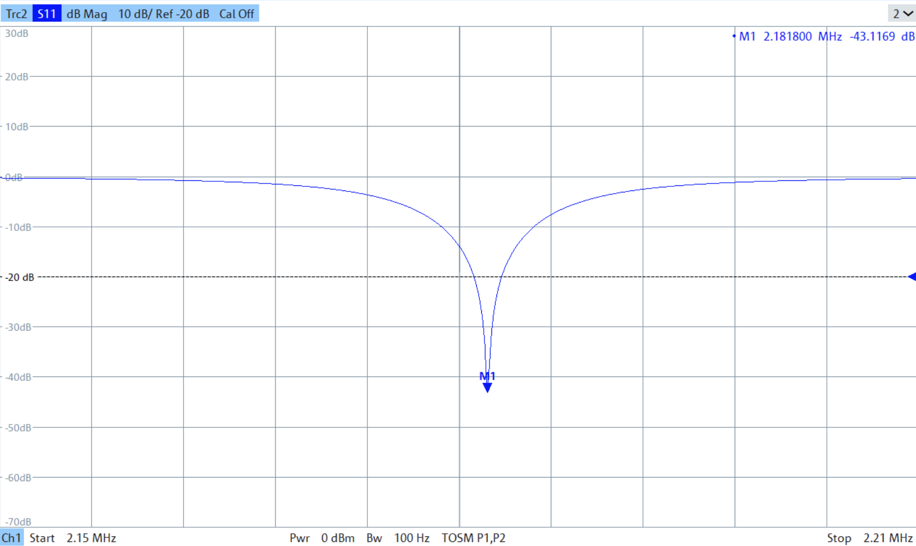
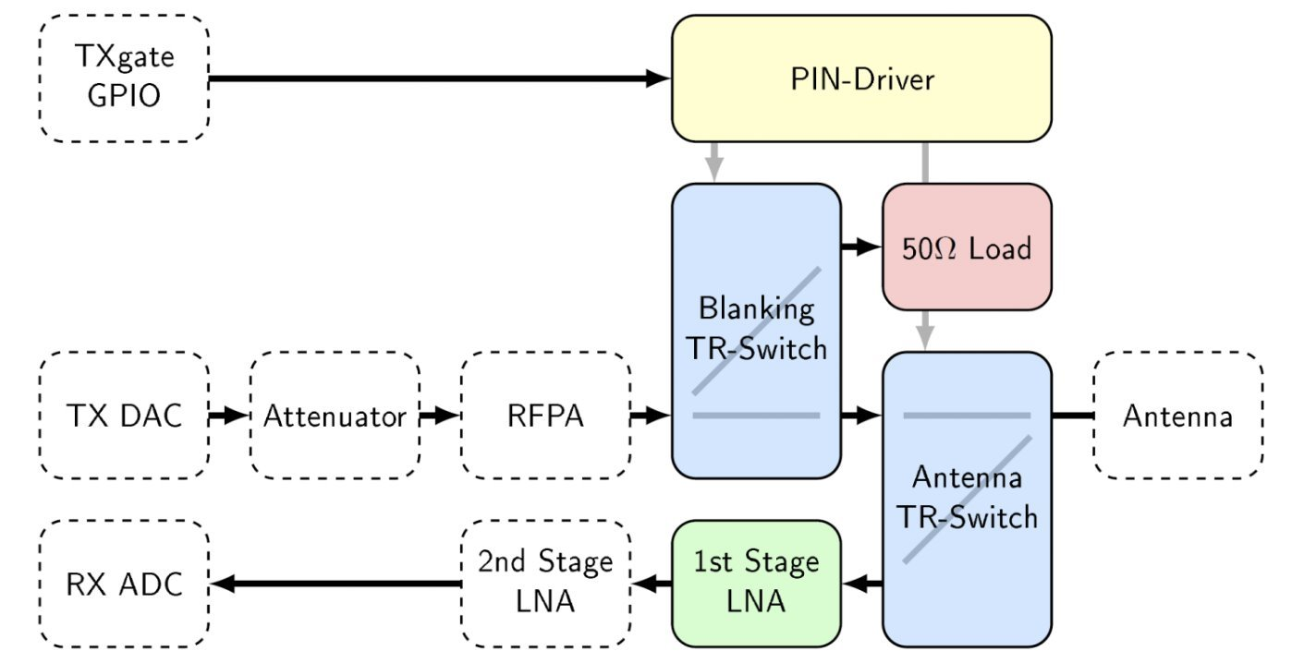
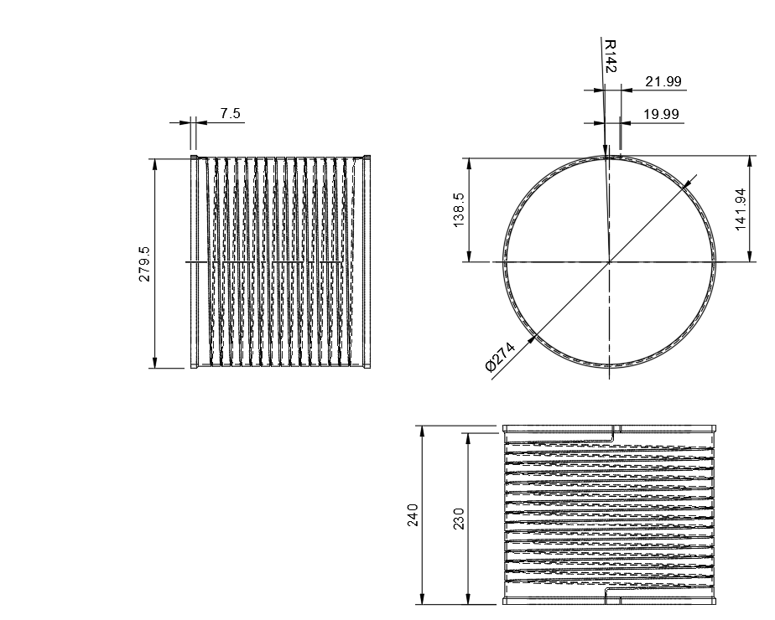
A Radio Frequency Coil for Ultra Low-Field MRI
Author(s): Jennifer Bee, Sonny Bruni, Yuri Lemermeyer, Kenshin Pacle, Spencer Tourigny, Ian Washington
Department of Electrical and Software Engineering at Schulich School of Engineering
Introduction and Background
Tuning Circuit
Simulations
Magnetic Resonance Imaging (MRI) is a key medical diagnostic tool. However, it is expensive because of the large magnetic fields it uses.
We manipulate the resonant frequency of the coil by adding capacitance in parallel.
Series capacitance is added to maximize power transfer through impedance matching.
We simulated our coil’s resonant frequency and inductance to validate experimental results.
Ultra-Low Field (ULF) MRI uses much lower magnetic fields, giving it the potential to make healthcare more affordable and accessible.
Our project is the RF coil system of a ULF MRI. This system both excites the specimen and receives the signal it produces, which is processed into the image.
Simulated resonant frequency: 4.221MHz
Simulated inductance: 50μH
Radio Frequency Excitation
RF Excitation is a phenomena where short bursts of radio waves at a specific frequency tilt the atoms of a magnetized sample away from a resting position.
Results
Achieved 2.18MHz tune with -43dB match
Quality Factor (loaded with specimen): 175
Tuning of 2.18MHz ensures sample nuclei are properly excited.
Matched coil below -25dB indicates high efficiency power transfer.
As the atoms decay back to their resting position, a distinct signal is produced which is used for imaging.
RF Amplifier
Q Factor > 88 meets our goal for frequency selectivity because of its impact on signal to noise ratio.
The amplifier boosts a small signal, so the coil creates a strong enough field to tilt to the atoms. It is controlled via a 25-pin interface, by an Arduino and in-house GUI.
Coil Design
Experimental resonant frequency: 4.148MHz
Experimental inductance: 54μH
Outer and inner diameters are 28.4cm and 26.4cm
The coil has 15 turns, which sets the inductance
Transmit and Receive Switch
Geometric constraints permit measurement of adult heads and accommodate our sponsor’s existing ULF system.
The TR switch isolates the transmit and receive paths and quickly switches between them.
Several factors including power handling and attenuation were considered for the selected design.

